Slide 1
Chapter 10: OSPFv3
Instructor Materials
CCNP Enterprise: Core Networking

Slide 2
Chapter 10 Content
This chapter covers the following content:
OSPFv3 Fundamentals: This section provides an overview of the OSPFv3 routing protocol and the similarities to OSPFv2.
OSPFv3 Configurations: This section demonstrates the configuration and verification of an OSPFv3 environment.
IPv4 Support in OSPFv3: This section explains and demonstrates how OSPFv3 can be used for exchanging IPv4 routes.

Slide 3
OSPFv3 Fundamentals
OSPFv3 supports IPv4 and IPv6 address families.
New LSA types have been created to carry IPv6 prefixes.
The IP prefix information is carried as LSA payload information, making the protocol essentially address family independent.
Includes a new link-state type field that is used to determine the flooding scope of LSA, as well as the handling of unknown LSA types.
OSPFv3 runs directly over IPv6, and the number of fields in the packet header has been reduced.

Slide 4
OSPFv3 Fundamentals Features
Router ID - The router ID is used to identify neighbors, regardless of the network type in OSPFv3. The router ID must always be manually assigned in the routing process.
Authentication - Neighbor authentication has been removed from the OSPF protocol and is now performed through IPsec extension headers in the IPv6 packet.
Neighbor adjacencies - OSPFv3 inter-router communication is handled by IPv6 link-local addressing.
Multiple subnets on an interface - Allows for neighbor adjacency to form even if the two routers do not share a common subnet.
Multiple instances - OSPFv3 packets include an instance ID field that may be used to manipulate which routers on a network segment are allowed to form adjacencies.

Slide 5
OSPFv3 Fundamentals OSPFv3 Link-State Advertisement
OSPFv3 packets use protocol ID 89.
Routers communicate with each other using the link-local address.
OSPFv3 modifies the structure of the router LSA (type 1).
It renames the network summary LSA to the interarea prefix LSA.
It renames the ASBR summary LSA to the interarea router LSA.
Router LSA is responsible for announcing interface parameters such as the interface type and metric.
IP address information is advertised independently by two new LSA types:
Intra-area prefix LSA
Link-local LSA
Link-state database(LSDB) creates a shortest path topology tree based on links instead of networks. Since IP address information is advertised using new LSA types there is no longer a need to run SPF calculations every time a new address prefix is added or changed on an interface.

Slide 6
OSPFv3 Fundamentals OSPFv3 Link-State Advertisement
LS Type | Name | Description
0x2001 | Router | Every router generates router LSAs that describe the state and cost of the router’s interfaces to the area.
0x2002 | Network | A designated router generates network LSAs to announce all of the routers attached to the link, including itself.
0x2003 | Interarea Prefix | Area border routers generate interarea prefix LSAs to describe routes to IPv6 address prefixes that belong to other areas.
0x2004 | Interarea router | Area border routers generate interarea router LSAs to announce the addresses of autonomous system boundary routers in other areas.
0x4005 | AS external | Autonomous system boundary routers advertise AS external LSAs to announce default routes or routes learned through redistribution from other protocols.
0x2007 | NSSA | Autonomous system boundary routers that are located in a not-so-stubby area advertise NSSA LSAs for routes redistributed into the area.
0x0008 | Link | The link LSA maps all of the global unicast address prefixes associated with an interface to the link-local interface IP address of the router. The link LSA is shared only between neighbors on the same link.
0x2009 | Intra-area prefix | The intra-area prefix LSA is used to advertise one or more IPv6 prefixes that are associated with a router, stub, or transit network segment.
Table 10-2 OSPFv3 LSA Types

Slide 7
OSPFv3 Fundamentals OSPFv3 Communication
Destination address is either a unicast link-local address or a multicast link-local scoped address:
FF02::05: OSPFv3 AllSPFRouters
Every router uses AllSPFRouters multicast address to send OSPF hello messages to routers on the same link.
Hello messages are used for neighbor discovery and detecting whether a neighbor relationship is down.
DR and BDR routers also use this address to send link-state update and flooding acknowledgment messages to all routers.
FF02::06: OSPFv3 AllDRouters designated router (DR)
Non-DR/BDR routers send an update or link-state acknowledgment message to the DR and BDR by using the AllDRouters.
OSPFv3 uses the same five packet types and logic as OSPFv2.

Slide 8
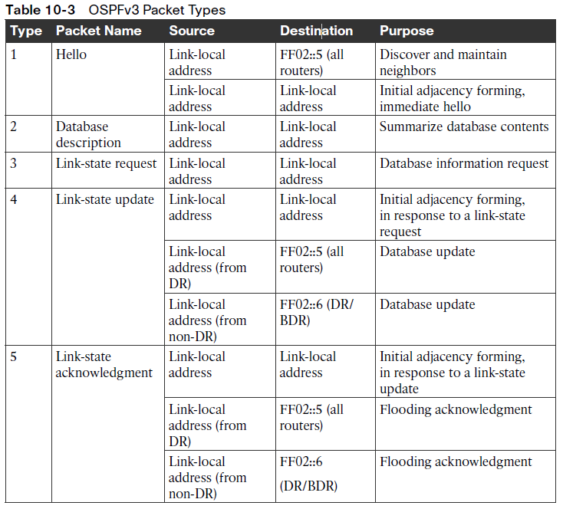
OSPFv3 Fundamentals OSPFv3 Packet Types

Slide 9
OSPFv3 Configurations
Configuration Steps:
Step 1. Initialize the routing process with the command 'ipv6 unicast-routing'.
Step 2. Define the 32-bit router ID within the OSPFv3 router process.
Step 3. (Optional) Initialize the address family - enabled automatically when OSPFv3 is enabled on an interface.
Step 4. Enable OSPFv3 on an interface using a process-id and area-id.

Slide 10
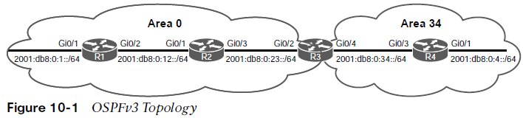
OSPFv3 Configurations OSPFv3 Topology
Figure 10-1 displays a simple four-router topology to demonstrate OSPFv3 configuration.
Area 0 consists of R1, R2, and R3, and Area 34 contains R3 and R4. R3 is the ABR.

Slide 11
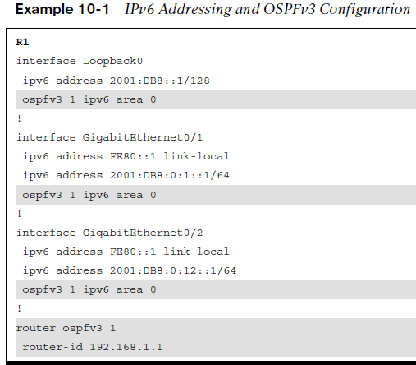
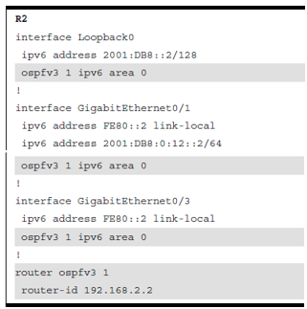
OSPFv3 Configurations Example OSPFv3 Configuration
Earlier versions of IOS used the commands ipv6 router ospf for initialization of the OSPF process and ipv6 ospf process-id area area-id for identification of the interface. These commands are considered legacy and should be migrated to the current practice such as ospfv3 process-id ipv6 area area-id in the R1 & R2 configurations, as highlighted below.

Slide 12
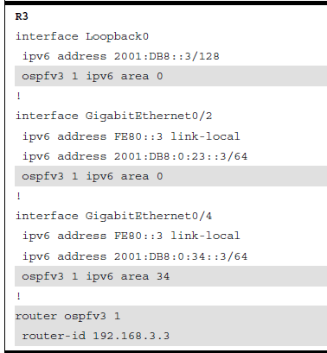
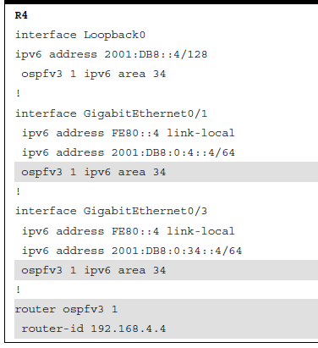
OSPFv3 Configurations Example OSPFv3 Configuration (Cont.)
R3 & R4 configurations steps are highlighted below.

Slide 13
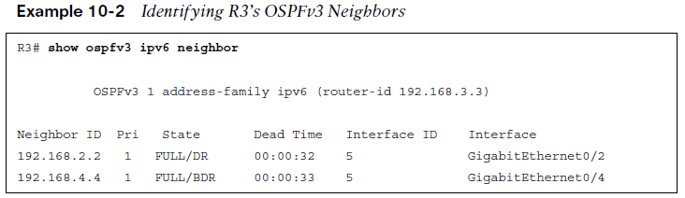
OSPFv3 Configurations OSPFv3 Verification – Neighbor Adjacency
To view the R3 OSPFv3 Neighbor Adjacency the show opsfv3 ipv6 neighbor command is used.
Neighbors router-id is displayed, OSPFv3 priority, state of the connection, and the interface the neighbor is learned on.

Slide 14
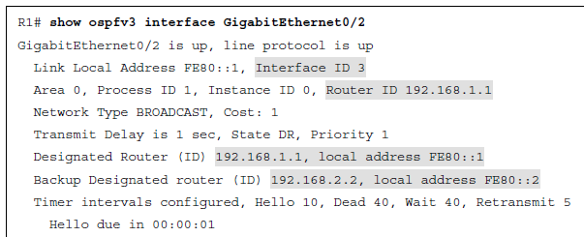
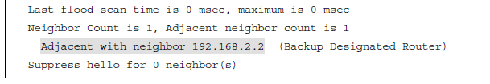
OSPFv3 Configurations OSPFv3 Verification
Verifying the OSPFv3 interface information provides the following:
Interface ID
Router ID
DR and Backup DR
Neighbor Adjacency

Slide 15
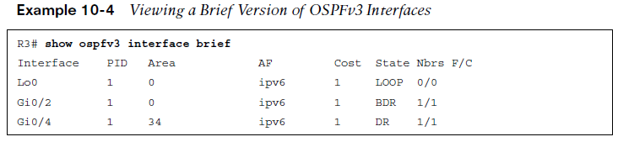
OSPFv3 Configurations OSPFv3 Interface Verification
To show a brief listing of the interfaces participating in OSPFv3 Routing on R3 use the show ospfv3 interface brief command.
Important information includes the Interface, the area the interface belongs to, and the role of the router on the link (State)

Slide 16
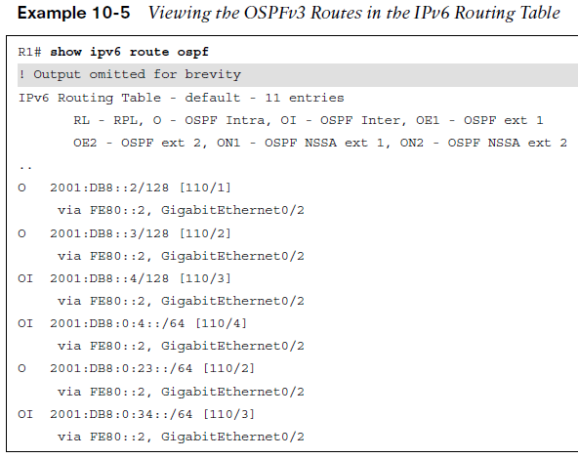
OSPFv3 Configurations OSPFv3 Routing Verification
Output from the OSPFv3 routing table showing both Intra-Area routes (O) and Inter-Area routes (OI) using the command show ipv6 route ospf.

Slide 17
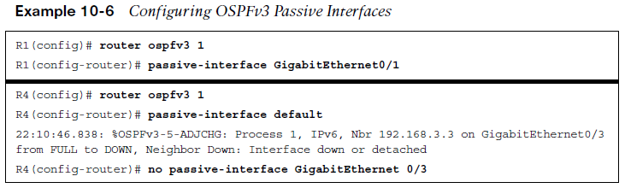
OSPFv3 Configurations OSPFv3 Passive Interface
OSPFv3 supports marking an interface as passive. The command is placed under the OSPFv3 process or under the specific address family. Placing the command under the global process cascades the setting to both address families.
The passive interface can be set explicitly to an interface (R1 configuration).
The passive interface can be set as default (R4 configuration).

Slide 18
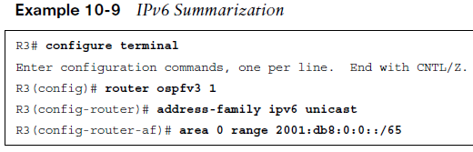
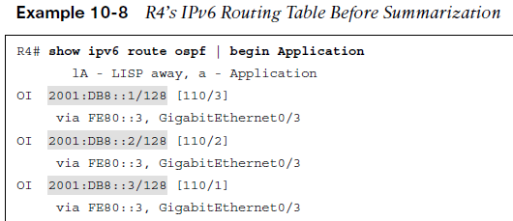
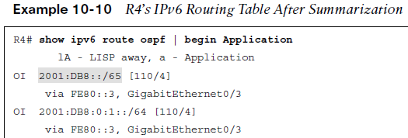
OSPFv3 Configurations OSPFv3 Route Summarization
Example 10-9 shows the summarization commands applied to R3.
Route summarization reduces the number of route entries on the neighboring router as shown in examples 10-8 and 10-10.

Slide 19
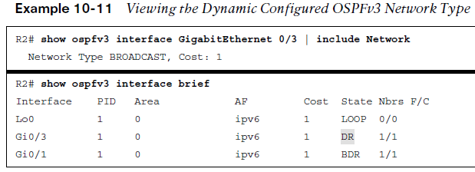
OSPFv3 Configurations OSPFv3 Verify Network Type
Configuration changes may be necessary for a dynamically learned network type. As shown in Example 10-11 the R2 G0/3 interface is shown as a BROADCAST network type.
Based on the topology it should be a point-to-point.

Slide 20
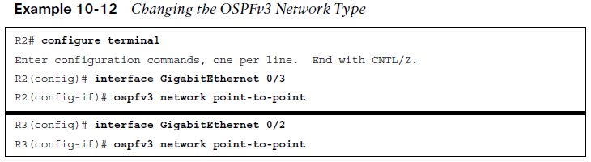
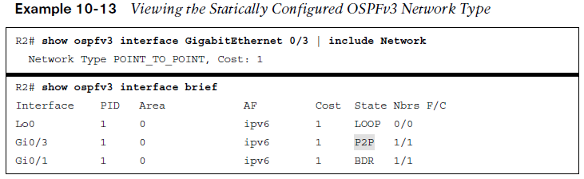
OSPFv3 Configurations OSPFv3 Change Network Type
When changes are made to the network type it is necessary to change both ends of the link to match. The change is made directly on the interface.

Slide 21
IPv4 Support in OSPFv3
Enabling IPv4 Support
Step 1. Ensure that the IPv4 interface has an IPv6 address (global or link local) configured.
Step 2. Enable the OSPFv3 process for IPv4 on the interface with the command ospfv3 process-id ipv4 area area-id.

Slide 22
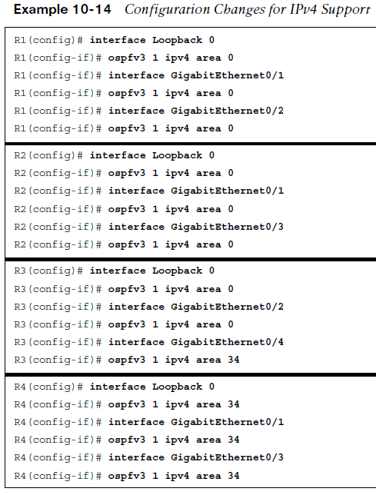
IPv4 Support in OSPFv3 Adding IPv4 support to existing interfaces
Using the command ospfv3 process-id ipv4 area area-id on an interface configured for IPv6 adds IPv4 support. The interface must have an IPv6 global or link-local address.

Slide 23
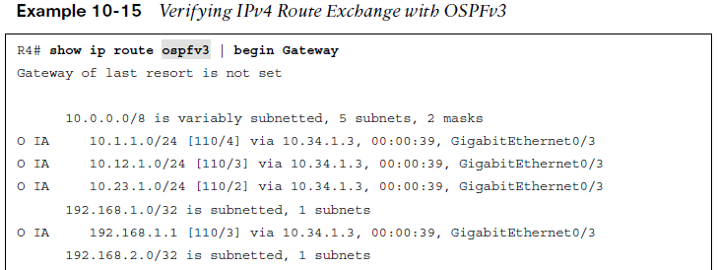
IPv4 Support in OSPFv3 Verifying IPv4 Routes
Verifying OSPFv3 routes for IPv4 is accomplished using the command show ip route ospfv3.

Slide 24
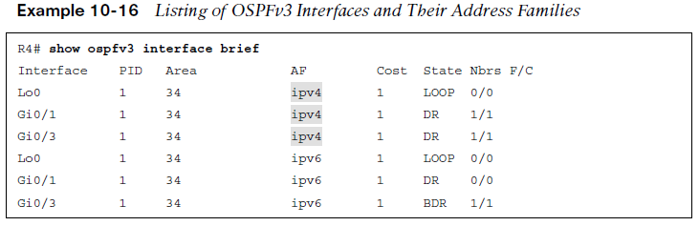
IPv4 Support in OSPFv3 Displaying OSPFv3 Interfaces
To display the interfaces configured for OSPFv3 and the respective address family use the command show ospfv3 interface brief.

Slide 25
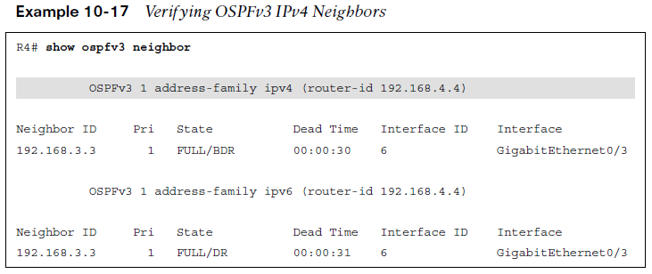
IPv4 Support in OSPFv3 Verifying OSPFv3 Neighbors
To verify the OSPFv3 neighbors for both IPv4 and IPv6 use the command show ospfv3 neighbor.

Slide 26
Prepare for the Exam

Slide 27
Prepare for the Exam Key Topics for Chapter 10
Description
OSPFv3 fundamentals
OSPFv3 Packet Types
OSPFv3 verification
OSPFv3 summarization
IPv4 support on OSPFv3

Slide 28
Prepare for the Exam Command Reference for Chapter 10
Task | Command Syntax
Configure OSPFv3 on a router and enable it on an interface | router ospfv3 [process-id] interface interface-id ospfv3 process-id {ipv4 | ipv6} area area-id
Configure a specific OSPFv3 interface as passive | passive-interface interface-id
Configure all OSPFv3 interfaces as passive | passive-interface default
Summarize an IPv6 network range on an ABR | area area-id range prefix/prefix-length
Configure an OSPFv3 interface as point-to-point or broadcast network type | ospfv3 network {point-to-point | broadcast}

Slide 29
Prepare for the Exam Command Reference for Chapter 10 (Cont.)
Task | Command Syntax
Display OSPFv3 interface settings | show ospfv3 interface [interface-id]
Display OSPFv3 IPv6 neighbors | show ospfv3 ipv6 neighbor
Display OSPFv3 router LSAs | show ospfv3 database router
Display OSPFv3 network LSAs | show ospfv3 database network
Display OSPFv3 link LSAs | show ospfv3 database link

